Slide 1
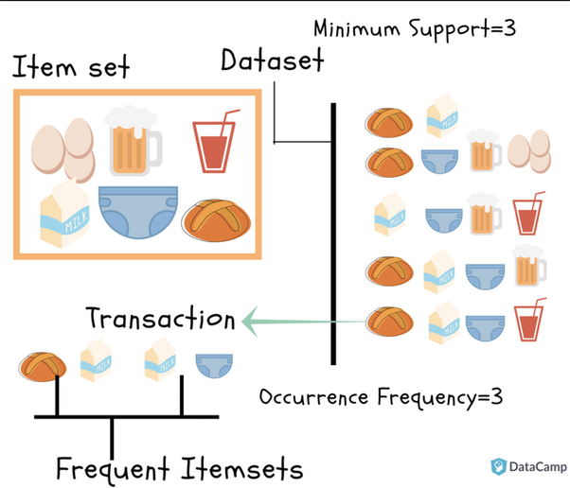

Module III – Association Rule Mining
(DSC3101) – BTech- CSE(DS) – Taken by NB

Slide 2
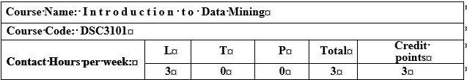
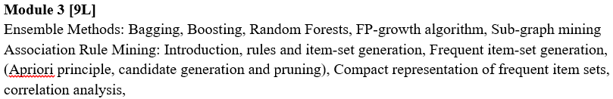
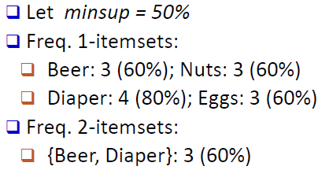
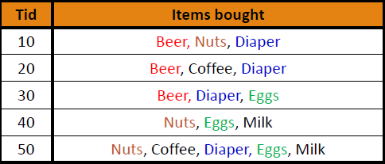

Slide 3
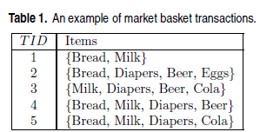
Association Rule Mining
Many business enterprises accumulate large quantities of data from their day-to-day operations.
or example, huge amounts of customer purchase data are collected daily at the checkout counters of grocery stores. Table 1 gives an example of such data, commonly known as market basket transactions.
Each row in this table corresponds to a transaction, which contains a unique identifier labeled TID and a set of items bought by a given customer.
Retailers are interested in analyzing the data to learn about the purchasing behavior of their customers.
Such valuable information can be used to support a variety of business-related applications such as marketing promotions, inventory management, and customer relationship management.

Slide 4
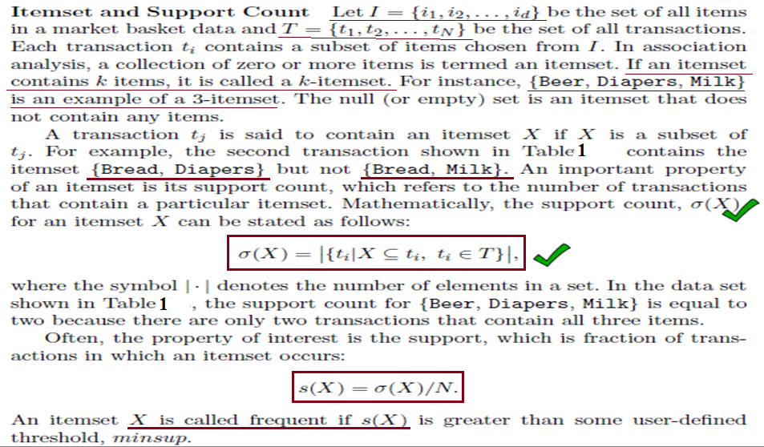
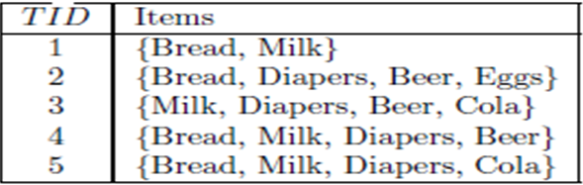

Slide 5
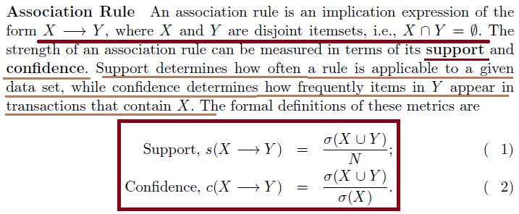

Slide 6
Association Rule Mining
Given a set of transactions, find rules that will predict the occurrence of an item based on the occurrences of other items in the transaction
Market-Basket transactions
Example of Association Rules
{Diaper} → {Beer},
{Beer} → {Diaper} {Milk, Bread} → {Eggs,Coke}, {Beer, Bread} → {Milk},
{Bread, Milk, Diaper} → {Coke}
Implication means co-occurrence, not causality!

Slide 7
Definition: Frequent Itemset
Itemset
A collection of one or more items
Example: {Milk, Bread, Diaper}
k-itemset
An itemset that contains k items
Support count (σ)
Frequency of occurrence of an itemset
E.g. σ({Milk, Bread,Diaper}) = 2
Support (relative support)
Fraction of transactions that contain an itemset
E.g. s({Milk, Bread, Diaper}) = 2/5
Frequent Itemset
An itemset whose support is greater than or equal to a minsup threshold

Slide 8
Definition: Association Rule
Association Rule
An implication expression of the form X → Y, where X and Y are itemsets
Example: {Milk, Diaper} → {Beer}
Rule Evaluation Metrics
Support (s)
Fraction of transactions that contain both X and Y
Confidence (c)
Measures how often items in Y appear in transactions that contain X
Example:

Slide 9
Association Rule Mining Task
Given a set of transactions T, the goal of association rule mining is to find all rules having
support ≥ minsup threshold
confidence ≥ minconf threshold
Brute-force approach:
List all possible association rules
Compute the support and confidence for each rule
Prune rules that fail the minsup and minconf thresholds
⇒ Computationally prohibitive!

Slide 10
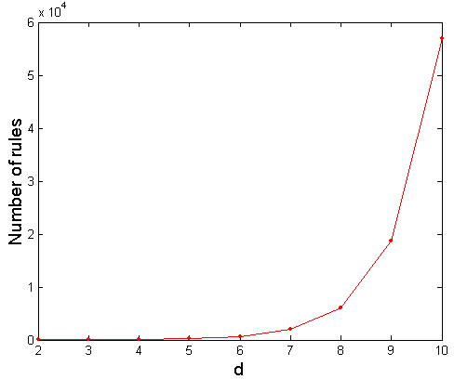
Computational Complexity
Given d unique items:
Total number of itemsets = 2^{d}
Total number of possible association rules:
If d=6, R = 602 rules

Slide 11
Mining Association Rules
Example of Rules:
{Milk,Diaper} → {Beer} (s=0.4, c=0.67) {Milk,Beer} → {Diaper} (s=0.4, c=1.0)
{Diaper,Beer} → {Milk} (s=0.4, c=0.67)
{Beer} → {Milk,Diaper} (s=0.4, c=0.67) {Diaper} → {Milk,Beer} (s=0.4, c=0.5)
{Milk} → {Diaper,Beer} (s=0.4, c=0.5)
Observations:
All the above rules are binary partitions of the same itemset: {Milk, Diaper, Beer}
Rules originating from the same itemset have identical support but can have different confidence
Thus, we may decouple the support and confidence requirements

Slide 12
Tid | Items bought [Table-1]
10 | Beer, Nuts, Diapers
20 | Beer, Coffee, Diapers, Nuts
30 | Beer, Diapers, Eggs
40 | Beer, Nuts, Eggs, Milk
50 | Nuts, Coffee, Diapers, Eggs, Milk
Given the five transactions in Table-1, mini_support(minsup) s = 50%
Which of the following in NOT a frequent itemset?
Coffee b) Eggs c) {Beer, Diapers} d) Beer
Ans: a) Coffee → 2 (s = 2_{/5} → 40%)
b) Eggs → 3 (s = 3_{/5} → 60%)
c) {Beer, Diapers} → 3 (s = 3_{/5} → 60%)
d) {Beer} → 4 (s = 4_{/5} → 80%)

Slide 13
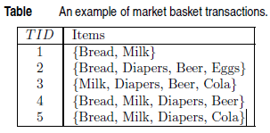
Association rule analysis of frequent patterns….
What is the support, relative support and confidence of the association rules : Bread → Milk, {Milk, Diapers} → Beer, Diapers → {Milk, Cola} ?
Ans: Support (s) for Bread: 4 out of 5 transactions, Relative Support: 4_{/5}. Support (s) for Milk: 4 out of 5 transactions, Relative support: 4_{/5} = 80%.
Now the association rule Bread → Milk asks for ‘what is the confidence that customer buying Bread will definitely buy Milk?’ thus, Confidence = s(Bread → Milk)_{/s(Bread)} = ¾ = .75

Slide 14
Transactions from a database :-
Tid | Items bought [Table-1]
10 | Beer, Nuts, Diapers
20 | Beer, Coffee, Diapers, Nuts
30 | Beer, Diapers, Eggs
40 | Beer, Nuts, Eggs, Milk
50 | Nuts, Coffee, Diapers, Eggs, Milk
Given, min-support (minsup), s = 50%, min-confidence (minconf), c = 50%. Which of the following is/are association rule(s) ?
Beer → Nuts,
coffee → milk,
Nuts → Diapers,
Diapers → eggs,
Nuts → eggs

Slide 15
Beer → Nuts :
Ans: for transactions that has beer and nuts both, i.e., customers buying beer are also buying nuts, i.e., frequent-itemset (count for beer ∪ nuts) : 3.
Total transactions (T) = 5; support, s = 3_{/5} (60%); confidence (c) = (beer → nuts)_{/beer} = 3_{/4} = 75%
(b) Coffee → Milk : Customers buying coffee also buying milk, support (s) = 1_{/5} (20%), confidence (c) = 1_{/2} (50%)
(c) Nuts → Diapers : s = 3_{/5} (60%); c = 3_{/4} (75%)
(d) Diapers → Eggs : s = 2_{/5} (40%); c = 2_{/4} (50%)
(e) Nuts → Eggs : s = 2_{/5} (40%); c = 2_{/4} (50%)
Given the transactions in Table-I, what is the confidence (c) and relative support (s) of the association rule, diapers → {coffee, nuts}.
Support = 2, relative support (s) = 2_{/5} (40%) (0.4)
Confidence = (diapers → coffee, nuts)/diapers = 2/4 = 50% (0.5).

Slide 16
Mining Association Rules
Two-step approach:
Frequent Itemset Generation
Generate all itemsets whose support ≥ minsup
Rule Generation
Generate high confidence rules from each frequent itemset, where each rule is a binary partitioning of a frequent itemset
frequent itemset generation is still computationally expensive
Tid | Items bought
10 | Beer, Nuts, Diapers
20 | Beer, Coffee, Diapers, Nuts
30 | Beer, Diapers, Eggs
40 | Beer, Nuts, Eggs, Milk
50 | Nuts, Coffee, Diapers, Eggs, Milk

Slide 17
Frequent Itemset Generation
A lattice structure can be used to enumerate the list of all possible item sets. Figure 2 shows an item set lattice for I = {a, b, c, d, e}. In general, a data set that contains k items can potentially generate up to 2^{k} −1 frequent item sets, excluding the null set. Because k can be very large in many practical applications, the search space of item sets that need to be explored is exponentially large.
A brute-force approach for finding frequent item sets is to determine the support count for every candidate item set in the lattice structure. To do this, we need to compare each candidate against every transaction, an operation that is shown in Figure 2. If the candidate is contained in a transaction, its support count will be incremented. For example, the support for {Bread, Milk} is incremented three times because the item set is contained in transactions 1, 4, and 5. Such an approach can be very expensive because it requires O(NMw) comparisons, where N is the number of transactions, M = 2^{k} −1 is the number of candidate itemsets, and w is the maximum transaction width. Transaction width is the number of items present in a transaction.

Slide 18
Frequent Itemset Generation
Figure-2: Given d items, there are 2^{d} possible candidate item sets

Slide 19
Frequent Itemset Generation
Brute-force approach:
Each itemset in the lattice is a candidate frequent itemset
Count the support of each candidate by scanning the database
Match each transaction against every candidate
Complexity ~ O(NMw) => Expensive since M = 2^{d} !!!

Slide 20
Frequent Itemset Generation Strategies
Reduce the number of candidates (M)
Complete search: M=2^{d}
Use pruning techniques to reduce M
Reduce the number of transactions (N)
Reduce size of N as the size of itemset increases
Used by DHP and vertical-based mining algorithms
Reduce the number of comparisons (NM)
Use efficient data structures to store the candidates or transactions
No need to match every candidate against every transaction

Slide 21
The Apriori Principle
We have to check how the support measure can be used to reduce the
number of candidate itemsets explored during frequent itemset generation. The use of support for pruning candidate itemsets is guided by the following principle.
(Apriori Principle). If an itemset is frequent, then all of its
subsets must also be frequent.
To illustrate the idea behind the Apriori principle, consider the itemset lattice shown in Figure 3. Suppose {c, d, e} is a frequent itemset. Clearly, any transaction that contains {c, d, e} must also contain its subsets, {c, d}, {c, e}, {d, e}, {c}, {d}, and {e}. As a result, if {c, d, e} is frequent, then all subsets of {c, d, e} (i.e., the shaded itemsets in this figure) must also be frequent.
Conversely, if an itemset such as {a, b} is infrequent, then all of its supersets must be infrequent too. As illustrated in Figure 4, the entire subgraph containing the supersets of {a, b} can be pruned immediately once {a, b} is found to be infrequent. This strategy of trimming the exponential search space based on the support measure is known as support-based pruning. Such a pruning strategy is made possible by a key property of the support measure, namely, that the support for an itemset never exceeds the support for its subsets. This property is also known as the anti-monotone property of the support measure.

Slide 22
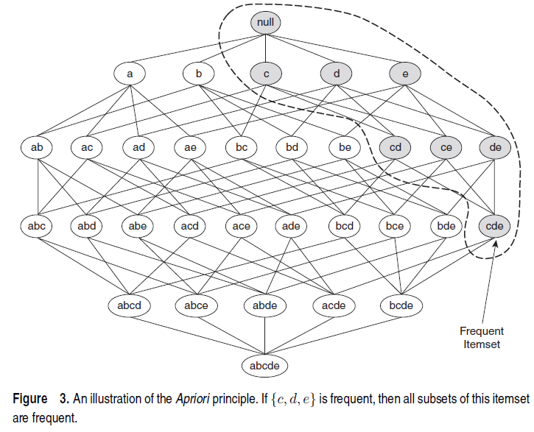

Slide 23
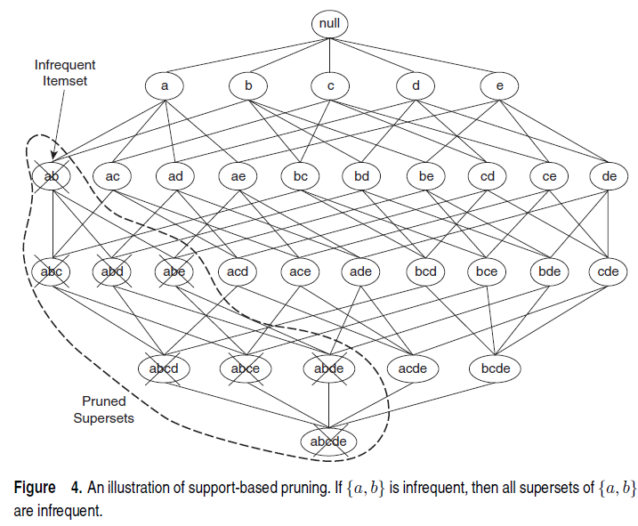

Slide 24
Reducing Number of Candidates
Apriori principle:
If an itemset is frequent, then all of its subsets must also be frequent
Apriori principle holds due to the following property of the support measure:
Support of an itemset never exceeds the support of its subsets
This is known as the anti-monotone property of support

Slide 25
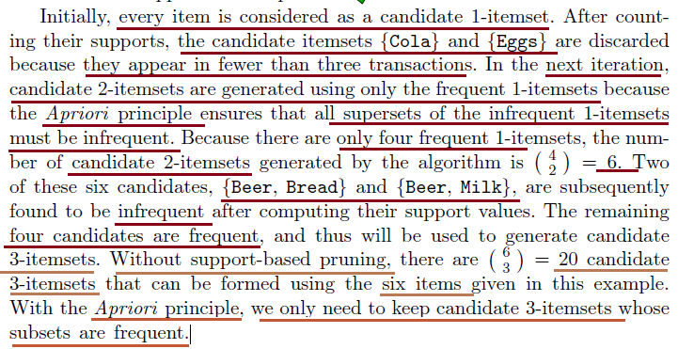
Frequent Itemset Generation in the Apriori Algorithm
Apriori is the first association rule mining algorithm that pioneered the use of support-based pruning to systematically control the exponential growth of candidate item sets.
Figure 5 provides a high-level illustration of the frequent itemset generation part of the Apriori algorithm for the transactions shown in Table-1.
We assume that the support threshold is 60%, which is equivalent to a minimum support count equal to 3.

Slide 26
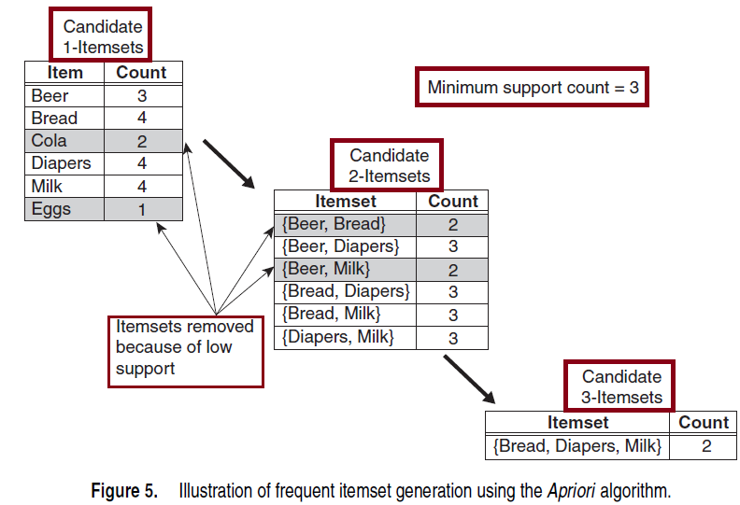
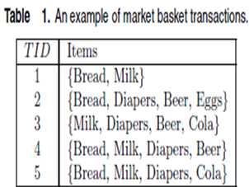

Slide 27
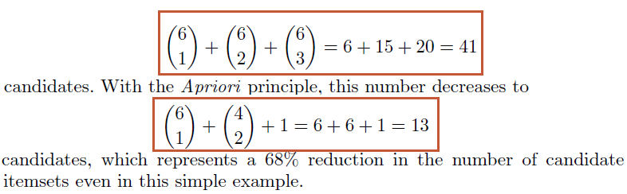
Frequent Itemset Generation in the Apriori Algorithm
The only candidate that has this property is {Bread, Diapers, Milk}.
However, even though the subsets of {Bread, Diapers, Milk} are frequent, the item set itself is not. The effectiveness of the Apriori pruning strategy can be shown by counting the number of candidate item sets generated. A brute-force strategy of enumerating all item sets (up to size 3) as candidates will produce:

Slide 28
Apriori Algorithm
F_{k}: frequent k-itemsets
L_{k}: candidate k-itemsets
Algorithm
Let k=1
Generate F₁ = {frequent 1-itemsets}
Repeat until F_{k} is empty
Candidate Generation: Generate L_{k+1} from F_{k}
Candidate Pruning: Prune candidate itemsets in L_{k+1} containing subsets of length k that are infrequent
Support Counting: Count the support of each candidate in L_{k+1} by scanning the DB
Candidate Elimination: Eliminate candidates in L_{k+1} that are infrequent, leaving only those that are frequent => F_{k+1}

Slide 29
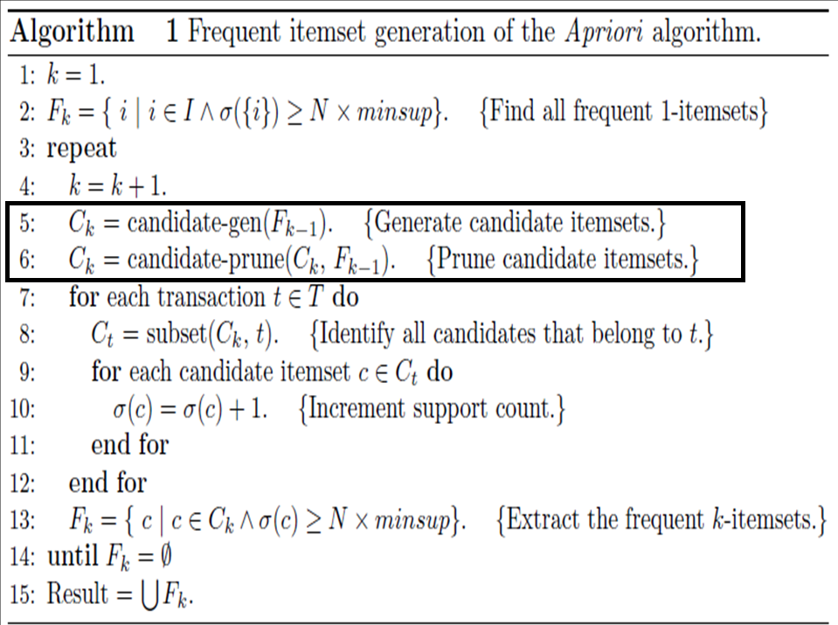

Slide 30
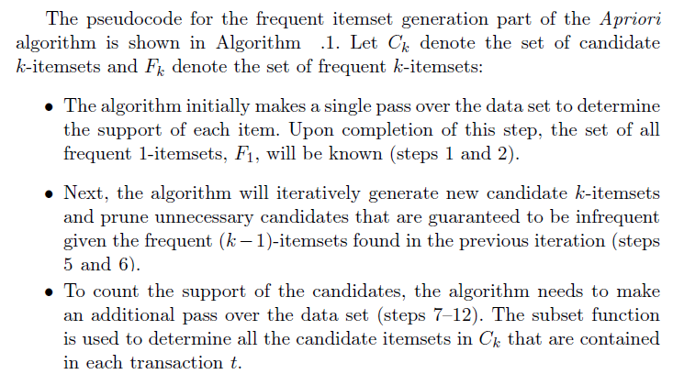
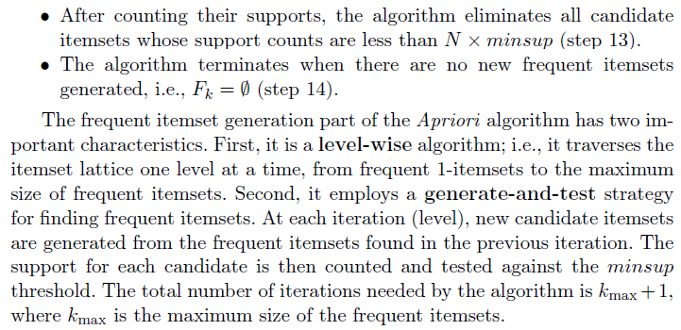

Slide 31
Illustrating Apriori Principle
Items (1-itemsets)
Minimum Support = 3
If every subset is considered,
⁶C₁ + ⁶C₂ + ⁶C₃
6 + 15 + 20 = 41
With support-based pruning,
6 + 6 + 4 = 16

Slide 32
Illustrating Apriori Principle
Items (1-itemsets)
Minimum Support = 3
If every subset is considered,
⁶C₁ + ⁶C₂ + ⁶C₃
6 + 15 + 20 = 41
With support-based pruning,
6 + 6 + 4 = 16

Slide 33
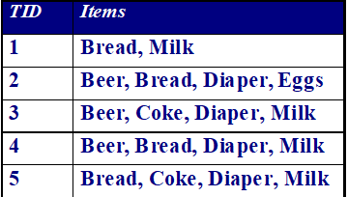
Illustrating Apriori Principle
Items (1-itemsets)
Pairs (2-itemsets)
(No need to generate candidates involving Coke or Eggs)
Minimum Support = 3
If every subset is considered,
⁶C₁ + ⁶C₂ + ⁶C₃
6 + 15 + 20 = 41
With support-based pruning,
6 + 6 + 4 = 16

Slide 34
Illustrating Apriori Principle
Items (1-itemsets)
Pairs (2-itemsets)
(No need to generate candidates involving Coke or Eggs)
Minimum Support = 3
If every subset is considered,
⁶C₁ + ⁶C₂ + ⁶C₃
6 + 15 + 20 = 41
With support-based pruning,
6 + 6 + 4 = 16

Slide 35
Illustrating Apriori Principle
Items (1-itemsets)
Pairs (2-itemsets)
(No need to generate candidates involving Coke or Eggs)
Minimum Support = 3
Triplets (3-itemsets)
If every subset is considered,
⁶C₁ + ⁶C₂ + ⁶C₃
6 + 15 + 20 = 41
With support-based pruning,
6 + 6 + 4 = 16

Slide 36
Illustrating Apriori Principle
Items (1-itemsets)
Pairs (2-itemsets)
(No need to generate candidates involving Coke or Eggs)
Minimum Support = 3
Triplets (3-itemsets)
If every subset is considered,
⁶C₁ + ⁶C₂ + ⁶C₃
6 + 15 + 20 = 41
With support-based pruning,
6 + 6 + 4 = 16
6 + 6 + 1 = 13

Slide 38
Candidate Generation and Pruning
The candidate-gen and candidate-prune functions shown in Steps 5 and 6 of Algorithm 1 generate candidate itemsets and prunes unnecessary ones by performing the following two operations, respectively:
1. Candidate Generation. This operation generates new candidate k-itemsets based on the frequent (k − 1)-itemsets found in the previous iteration.
2. Candidate Pruning. This operation eliminates some of the candidate k-itemsets using support-based pruning, i.e. by removing k-itemsets whose subsets are known to be infrequent in previous iterations. Note that this pruning is done without computing the actual support of these k-itemsets (which could have required comparing them against each transaction).

Slide 39
Candidate Generation and Pruning
In principle, there are many ways to generate candidate itemsets.
An effective candidate generation procedure must be complete and non-redundant.
A candidate generation procedure is said to be complete if it does not omit any frequent itemsets.
To ensure completeness, the set of candidate itemsets must subsume the set of all frequent itemsets, i.e., ∀k : F_{k} ⊆ C_{k}. A candidate generation procedure is non-redundant if it does not generate the same candidate itemset more than once.
For example, the candidate itemset {a, b, c, d} can be generated in many ways—by merging {a, b, c} with {d}, {b, d} with {a, c}, {c} with {a, b, d}, etc.
Generation of duplicate candidates leads to wasted computations and thus should be avoided for efficiency reasons.
Also, an effective candidate generation procedure should avoid generating too many unnecessary candidates. A candidate itemset is unnecessary if at least one of its subsets is infrequent, and thus, eliminated in the candidate pruning step.

Slide 40
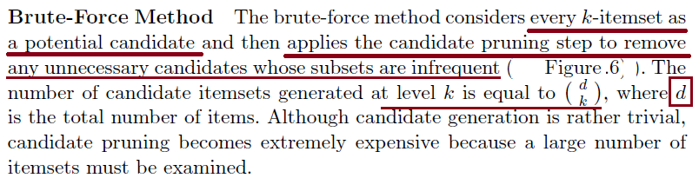
Candidate Generation and Pruning : Brute-force method

Slide 41

Candidate Generation and Pruning : Brute-force method
Figure - 6
σ = 2
Check Table-1 for support count

Slide 42

F_{k−1} × F₁ Method
An alternative method for candidate generation is to extend each frequent (k − 1)-itemset with frequent items that are not part of the (k − 1)-itemset.
Figure 7 illustrates how a frequent 2-itemset such as {Beer, Diapers} can be expanded with a frequent item such as Bread to produce a candidate 3-itemset {Beer, Diapers, Bread}.
The procedure is complete because every frequent k-itemset is composed of a frequent (k − 1)-itemset and a frequent 1-itemset. Therefore, all frequent k-itemsets are part of the candidate k-itemsets generated by this procedure.
Figure 7 shows that the F_{k−1} × F₁ candidate generation method only produces four candidate 3-itemsets, instead of the itemsets produced by the brute-force method.
The F_{k−1} × F₁ method generates lower number of candidates because every candidate is guaranteed to contain at least one frequent (k − 1)-itemset.
While this procedure is a substantial improvement over the brute-force method, it can still produce a large number of unnecessary candidates, as the remaining subsets of a candidate itemset can still be infrequent.

Slide 43
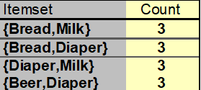
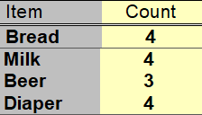
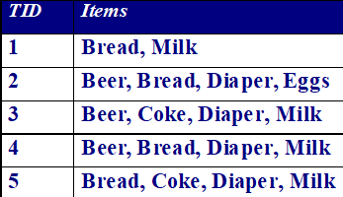
Candidate Generation: Merge F_{k-1} and F₁ itemsets
Figure - 7

Slide 44
Candidate Generation: F_{k-1} x F_{k-1} Method
This candidate generation procedure, which is used in the candidate-gen function of the Apriori algorithm, merges a pair of frequent (k−1)-itemsets only if their first k−2 items, arranged in lexicographic order, are identical.
Let A = {a₁, a₂, . . . , a_{k−1}} and B = {b₁, b₂, . . . , b_{k−1}} be a pair of frequent (k − 1)-itemsets, arranged lexicographically.
A and B are merged if they satisfy the following conditions:
a_{i} = b_{i} (for i = 1, 2, . . . , k − 2).
Note that in this case, a_{k−1} = b_{k−1} because A and B are two distinct itemsets. The candidate k-itemset generated by merging A and B consists of the first k − 2 common items followed by a_{k−1} and b_{k−1} in lexicographic order. This candidate generation procedure is complete, because for every lexicographically ordered frequent k-itemset, there exists two lexicographically ordered frequent (k − 1)-itemsets that have identical items in the first k − 2 positions.

Slide 45
In Figure 8, the frequent itemsets {Bread, Diapers} and {Bread, Milk} are merged to form a candidate 3-itemset {Bread, Diapers, Milk}.
The algorithm does not have to merge {Beer, Diapers} with {Diapers, Milk} because the first item in both itemsets is different.
Also, if we order the frequent (k−1)-itemsets according to their lexicographic rank, itemsets with identical first k − 2 items would take consecutive ranks. As a result, the F_{k−1} × F_{k−1} candidate generation method would consider merging a frequent itemset only with ones that occupy the next few ranks in the sorted list, thus saving some computations.
Figure 8 shows that the F_{k−1} × F_{k−1} candidate generation procedure results in only one candidate 3-itemset. This is a considerable reduction from the four candidate 3-itemsets generated by the F_{k−1} × F₁ method. This is because the F_{k−1} × F_{k−1} method ensures that every candidate k-itemset contains at least two frequent (k − 1)-itemsets, thus greatly reducing the number of candidates that are generated in this step.
For example, {Bread, Diapers} and {Diapers, Milk} could be merged using this approach to generate the candidate 3-itemset {Bread, Diapers, Milk}.

Slide 46
Candidate Generation: F_{k-1} x F_{k-1} Method
Fig - 8

Slide 47

For questions given below consider the
data Transactions :
I1, I2, I3, I4, I5, I6
I7, I2, I3, I4, I5, I6
I1, I8, I4, I5
I1, I9, I10, I4, I6
I10, I2, I4, I11, I5
Question. With support as 0.6 find all frequent itemsets?
<I1>, <I2>, <I4>, <I5>, <I6>, <I1, I4>, <I2, I4>, <I2, I5>, <I4, I5>, <I4, I6>, <I2, I4, I5>
b. <I2>, <I4>, <I5>, <I2, I4>, <I2, I5>, <I4, I5>, <I2, I4, I5>
c. <I11>, <I4>, <I5>, <I6>, <I1, I4>, <I5, I4>, <I11, I5>, <I4, I6>, <I2, I4, I5>
d. None of above

Slide 48
Solution:
Given data Transactions :
I1, I2, I3, I4, I5, I6
I7, I2, I3, I4, I5, I6
I1, I8, I4, I5
I1, I9, I10, I4, I6
I10, I2, I4, I11, I5
Unique Items | Support Count
I1
I2
I3
I4
I5
I6
I7
I8
I9
I10
I11
3
3
2
5
4
3
1
1
1
2
1
Frequent Item sets | Support Count | Relative Support
I1
I2
I4
I5
I6
I1, I4
I2, I4
I2, I5
I4, I5
I4, I6
I2, I4, I5
3 | .6
3 | .6
5 | 1.0
4 | .8
3 | .6
3 | .6
3 | .6
3 | .6
4 | .8
3 | .6
3 | .6
Ans: (a)

Slide 49
Candidate Generation: F_{k-1} x F_{k-1} Method
Merge two frequent (k-1)-itemsets if their first (k-2) items are identical
F₃ = {ABC,ABD,ABE,ACD,BCD,BDE,CDE}
Merge(ABC, ABD) = ABCD
Merge(ABC, ABE) = ABCE
Merge(ABD, ABE) = ABDE
Do not merge(ABD,ACD) because they share only prefix of length 1 instead of length 2

Slide 50
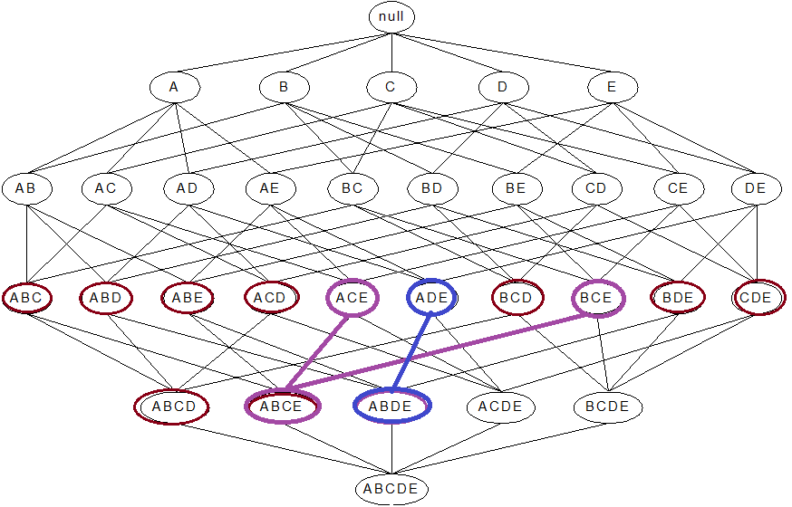

Slide 51
Candidate Pruning
Let F₃ = {ABC,ABD,ABE,ACD,BCD,BDE,CDE} be the set of frequent 3-itemsets
L₄ = {ABCD,ABCE,ABDE} is the set of candidate 4-itemsets generated (from previous slide)
Candidate pruning
Prune ABCE because ACE and BCE are infrequent
Prune ABDE because ADE is infrequent
After candidate pruning: L₄ = {ABCD}

Slide 52
Alternate F_{k-1} x F_{k-1} Method
Merge two frequent (k-1)-itemsets if the last (k-2) items of the first one is identical to the first (k-2) items of the second.
F₃ = {ABC,ABD,ABE,ACD,BCD,BDE,CDE}
Merge(ABC, BCD) = ABCD
Merge(ABD, BDE) = ABDE
Merge(ACD, CDE) = ACDE
Merge(BCD, CDE) = BCDE

Slide 53
Candidate Pruning for Alternate F_{k-1} x F_{k-1} Method
Let F₃ = {ABC,ABD,ABE,ACD,BCD,BDE,CDE} be the set of frequent 3-itemsets
L₄ = {ABCD,ABDE,ACDE,BCDE} is the set of candidate 4-itemsets generated (from previous slide)
Candidate pruning
Prune ABDE because ADE is infrequent
Prune ACDE because ACE and ADE are infrequent
Prune BCDE because BCE
After candidate pruning: L₄ = {ABCD}

Slide 54
Illustrating Apriori Principle
Items (1-itemsets)
Pairs (2-itemsets)
(No need to generate candidates involving Coke or Eggs)
Minimum Support = 3
Triplets (3-itemsets)
If every subset is considered,
⁶C₁ + ⁶C₂ + ⁶C₃
6 + 15 + 20 = 41
With support-based pruning,
6 + 6 + 1 = 13
Use of F_{k-1}xF_{k-1} method for candidate generation results in
only one 3-itemset. This is eliminated after the support counting step.

Slide 55
Rule Generation help → from F_{k-1} and F₁ itemsets
Y = {bread, milk, beer, diaper}, X = {bread, milk}, Y – X = {beer, diaper}
X → (Y - X) ➔ If {bread, milk} happens, then {beer, diaper} must occur too.
Figure - 7

Slide 56
Rule Generation
How to extract association rules efficiently from a given frequent itemset?
Each frequent k-itemset, Y , can produce up to 2^{k}−2 association rules, ignoring rules that have empty antecedents or consequents (i.e. Y→ ∅ or ∅ → Y).
Suppose, 3-itemset is {Bread, Diapers, Milk}
6 association rules to be made: ??
Bread → Diapers, Bread → Milk, Diapers → Milk, Milk → Bread, Milk → Diapers, Diapers → Bread
An association rule can be extracted by partitioning the itemset Y into two non-empty subsets, X and Y −X, such that X → Y −X satisfies the confidence threshold. Note that all such rules must have already met the support threshold because they are generated from a frequent itemset.
Y = {bread, milk, beer, diaper}, X = {bread, milk}, Y – X = {beer, diaper}; X → (Y - X) ➔ If {bread, milk} happens, then {beer, diaper} must occur too.

Slide 57
1. (a) What is the confidence for the rules ∅ → A and A → ∅?
Answer: c(∅ → A) = s(∅ → A). c(A → ∅) = 100%.
Hint: Each frequent k-itemset, Y , can produce up to 2^{k}−2 association rules, ignoring rules that have empty antecedents or consequents (i.e. Y→ ∅ or ∅ → Y).
If I say, Bread → ∅ or ∅ → Bread, what do I mean? I am buying only Bread, i.e., frequent-1 itemset and I am buying nothing after that. Thus, the association rule Bread → ∅ has relative support = s(Bread ∪ φ)/total no. of transactions = 4/5 = 80%. Confidence = s(Bread ∪ φ)/Occurrence of Bread = 4/4 = 1 (100%).
If I consider association rule ∅ → Bread, L.H.S is a null set. If I am not buying anything, i.e., based on nothing how can I buy something (ex. Bread).

Slide 58
Reducing Number of Candidates → helpful for next slide of rule generation
Apriori principle:
If an itemset is frequent, then all of its subsets must also be frequent
Apriori principle holds due to the following property of the support measure:
Support of an itemset never exceeds the support of its subsets
This is known as the anti-monotone property of support
{Bread, Milk, Diapers} is frequent, then, any subset of this frequent-3-itemset is also frequent, example: {Bread, Milk}, {Bread, Diapers}, {Milk, Diapers}, {Bread}, {Milk}, {Diapers}

Slide 59
Rule Generation
Example 1. Let X = {a, b, c} be a frequent itemset. There are six candidate association rules that can be generated from X: {a, b} → {c}, {a, c} → {b}, {b, c} → {a}, {a} → {b, c}, {b} → {a, c}, and {c} → {a, b}.
As each of their support is identical to the support for X, all the rules satisfy the support threshold.
Computing the confidence of an association rule does not require additional scans of the transaction data set.
Consider the rule {1, 2} → {3}, which is generated from the frequent itemset X = {1, 2, 3}.
The confidence for this rule is σ({1, 2, 3})/σ({1, 2}). Because {1, 2, 3} is frequent, the anti-monotone property of support ensures that {1, 2} must be frequent, too. Since the support counts for both itemsets were already found during frequent itemset generation, there is no need to read the entire data set again.

Slide 60
Rule Generation
Given a frequent itemset L, find all non-empty subsets f ⊂ L such that f → L – f satisfies the minimum confidence requirement
If {A,B,C,D} is a frequent itemset, candidate rules:
ABC →D, ABD →C, ACD →B, BCD →A, A →BCD, B →ACD, C →ABD, D →ABC AB →CD, AC → BD, AD → BC, BC →AD, BD →AC, CD →AB,
If |L| = k, then there are 2^{k} – 2 candidate association rules (ignoring L → ∅ and ∅ → L)

Slide 61
Rule Generation
In general, confidence does not have an anti-monotone property
c(ABC →D) can be larger or smaller than c(AB →D)
But confidence of rules generated from the same itemset has an anti-monotone property
E.g., Suppose {A,B,C,D} is a frequent 4-itemset: c(ABC → D) ≥ c(AB → CD) ≥ c(A → BCD)
Confidence is anti-monotone w.r.t. number of items on the RHS of the rule

Slide 62
Rule Generation for Apriori Algorithm
Lattice of rules
Low Confidence Rule
Pruned Rules

Slide 63
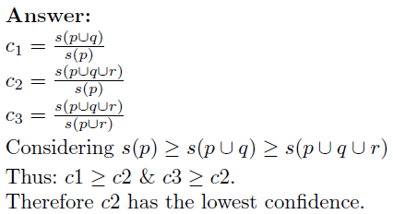
Question 2. Let c1, c2, and c3 be the confidence
values of the rules {p} → {q}, {p} → {q, r}, and
{p, r} → {q}, respectively.
If we assume that c1, c2, and c3 have different values, what are the possible relationships that may exist among c1, c2, and c3? Which rule has the lowest confidence?
Let’s solve this with real values:
Suppose, p = Bread, q = Milk, r = Diaper
c1 = s(p ∪ q)/s(p) = ¾ = .75
c2 = s(p ∪ q ∪ r)/s(p) = 2/4 = .5
c3 = s(p ∪ r ∪ q)/s(p ∪ r) = 2/3 = .67
BCD → A, B=coke, C=milk, D=diaper, A=beer,
c(BCD → A) = s(BCDA)/s(BCD)=1/2=.5;
A→BCD: c(A→BCD)=.5

Slide 64
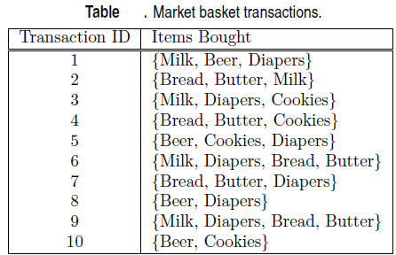

Question. Consider the market basket transactions shown in Table.
(a) What is the maximum number of association rules that can be extracted from this data (including rules that have zero support)?
(b) What is the maximum size of frequent itemsets that can be extracted (assuming minsup > 0)?
(c) Write an expression for the maximum number of size-3 itemsets that can be derived from this data set.
(d) Find an itemset (of size 2 or larger) that has the largest support.
(e) Find a pair of items, a and b, such that the rules {a} → {b} and {b} → {a} have the same confidence.
Answer (a): There are six items in the data set. Therefore the total number of rules is 602.
Answer (b): Because the longest transaction contains 4 items, the maximum size of frequent itemset is 4.
Answer © : ⁶C₃ = 20.
Answer (d): {Bread, Butter}.
Answer (e): (Beer, Cookies) or (Bread, Butter).

Slide 65
1. For each of the following questions, provide an example of an association rule from the market basket domain that satisfies the following conditions.
A rule that has high support and high confidence.
(b) A rule that has low support and low confidence.
(c) A rule that has support less than confidence.
Answer: Milk → Bread.
Answer: Milk → Cola.
Answer: Bread → Milk.

Slide 66
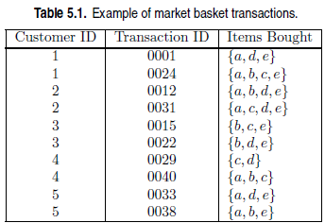
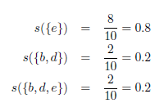

Consider the data set shown in Table 1.
(a) Compute the support for itemsets {e}, {b, d}, and {b, d, e} by treating
each transaction ID as a market basket.
(b) Use the results in part (a) to compute the confidence for the association rules {b, d} → {e} and {e} → {b, d}. Is confidence a symmetric
measure?

Slide 67
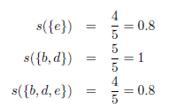
(c) Repeat part (a) by treating each customer ID as a market basket. Each item should be treated as a binary variable (1 if an item appears in at least one transaction bought by the customer, and 0 otherwise.)
(Part → a) Compute the support for itemsets {e}, {b, d}, and {b, d, e} by treating each transaction ID as a market basket.
Original, say, support threshold = 70%, Bread, Diaper, Milk will satisfy. If I reduce s to 60%, then, Milk would pass.

Slide 68
Question. Consider the following set of frequent 3-itemsets:
{1, 2, 3}, {1, 2, 4}, {1, 2, 5}, {1, 2, 6}, {1, 3, 4}, {1, 3, 5}, {1, 3, 6}, {2, 3, 4}, {2, 3, 5}, {2, 3, 6}, {3, 4, 5}.
(a) List all candidate 4-itemsets obtained by a candidate generation procedure using the F_{k−1} × F₁ merging strategy.
(b) List all candidate 4-itemsets obtained by the candidate generation procedure in Apriori.
Question: What will happen if support is reduced? (dataset in previous slide)
Number of frequent itemsets remains same
Some itemsets will add to the current set of frequent itemsets
Some itemsets will become infrequent while others will become frequent
Can not say
Ans: b

Slide 69
Compact Representation of Frequent Itemsets
The number of frequent itemsets produced from a transaction data set can be very large. It is useful to identify a small representative set of frequent itemsets from which all other frequent itemsets can be derived. Two such representations are a) maximal and b) closed frequent itemsets.
Maximal Frequent Itemsets
A frequent itemset is maximal if none of its immediate supersets are frequent.
Consider the itemset lattice shown in Figure A. The itemsets in the lattice are divided into two groups: those that are frequent and those that are infrequent. A frequent itemset border, which is represented by a dashed line, is also illustrated in the diagram. Every itemset located above the border is frequent, while those located below the border (the shaded nodes) are infrequent. Among the itemsets residing near the border, {a, d}, {a, c, e}, and {b, c, d, e} are maximal frequent itemsets because all of their immediate supersets are infrequent. For example, the itemset {a, d} is maximal frequent because all of its immediate supersets, {a, b, d}, {a, c, d}, and {a, d, e}, are infrequent. In contrast, {a, c} is non-maximal because one of its immediate supersets, {a, c, e}, is frequent.

Slide 70
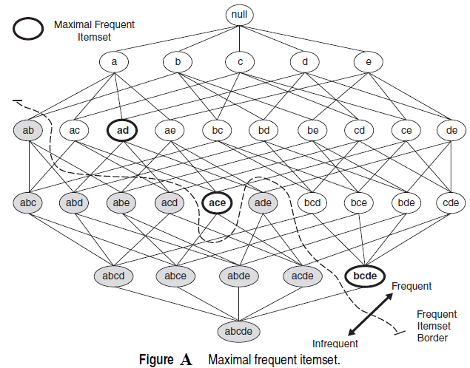
An itemset is maximal frequent if it is frequent and none of its immediate supersets is frequent

Slide 71
Maximal Frequent Itemsets
Maximal frequent itemsets effectively provide a compact representation of frequent itemsets. In other words, they form the smallest set of itemsets from which all frequent itemsets can be derived.
For example, every frequent itemset in Figure A is a subset of one of the three maximal frequent itemsets, {a, d}, {a, c, e}, and {b, c, d, e}.
If an itemset is not a proper subset of any of the maximal frequent itemsets, then it is either infrequent (e.g., {a, d, e}) or maximal frequent itself (e.g., {b, c, d, e}).
Hence, the maximal frequent itemsets {a, c, e}, {a, d}, and {b, c, d, e} provide a compact representation of the frequent itemsets shown in Figure A.
Enumerating all the subsets of maximal frequent itemsets generates the complete list of all frequent itemsets.

Slide 72
Closed Itemsets
Closed itemsets provide a minimal representation of all itemsets without losing their support information.
Definition of Closed Itemset: An itemset X is closed if none of its immediate supersets has exactly the same support count as X.
Put another way, X is not closed if at least one of its immediate supersets has the same support count as X.
Examples of closed itemsets are shown in Figure B.
To better illustrate the support count of each itemset, we have associated each node (itemset) in the lattice with a list of its corresponding transaction IDs.
For example, since the node {b, c} is associated with transaction IDs 1, 2, and 3, its support count is equal to three.
From the transactions given in this diagram, notice that the support for {b} is identical to {b, c}. This is because every transaction that contains b also contains c. Hence, {b} is not a closed itemset.
Similarly, since c occurs in every transaction that contains both a and d, the itemset {a, d} is not closed as it has the same support as its superset {a, c, d}.
On the other hand, {b, c} is a closed itemset because it does not have the same support count as any of its supersets.

Slide 73
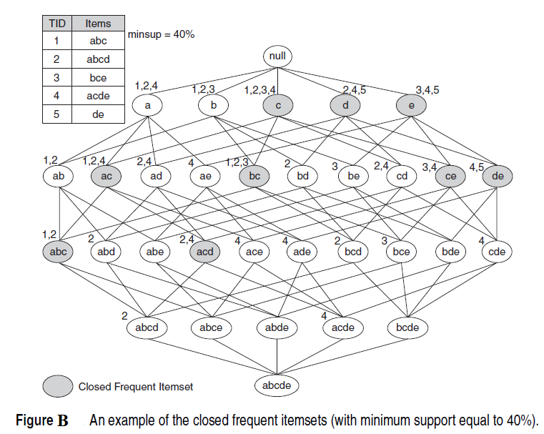
Closed Itemsets

Slide 74
Closed Itemsets
An interesting property of closed itemsets is that if we know their support counts, we can derive the support count of every other itemset in the itemset lattice without making additional passes over the data set.
For example, consider the 2-itemset {b, e} in Figure B.
Since {b, e} is not closed, its support must be equal to the support of one of its immediate supersets, {a, b, e}, {b, c, e}, and {b, d, e}.
Further, none of the supersets of {b, e} can have a support greater than the support of {b, e}, due to the anti-monotone nature of the support measure.
Hence, the support of {b, e} can be computed by examining the support counts of all of its immediate supersets of size three and taking their maximum value.
If an immediate superset is closed (e.g., {b, c, e}), we would know its support count.
Otherwise, we can recursively compute its support by examining the supports of its immediate supersets of size four.
In general, the support count of any non-closed (k − 1)-itemset can be determined as long as we know the support counts of all k-itemsets.
Hence, one can devise an iterative algorithm that computes the support counts of itemsets at level k−1 using the support counts of itemsets at level k, starting from the level kmax, where kmax is the size of the largest closed itemset.

Slide 75
Closed Itemsets
Even though closed itemsets provide a compact representation of the support counts of all itemsets, they can still be exponentially large in number.
Moreover, for most practical applications, we only need to determine the support count of all frequent itemsets.
In this regard, closed frequent itemsets provide a compact representation of the support counts of all frequent itemsets, which can be defined as follows.
Definition of Closed Frequent Itemset: An itemset is a closed frequent itemset if it is closed and its support is greater than or equal to minsup.

Slide 76
Closed Itemsets
To illustrate the advantage of using closed frequent itemsets, consider the data set shown in Table A, which contains ten transactions and fifteen items.
The items can be divided into three groups:
Group A, which contains items a1 through a5;
Group B, which contains items b1 through b5; and
Group C, which contains items c1 through c5.
Assuming that the support threshold is 20%, itemsets involving items from the same group are frequent, but itemsets involving items from different groups are infrequent.
The total number of frequent itemsets is thus 3 × (25 − 1) = 93. However, there are only four closed frequent itemsets in the data: ({a3, a4}, {a1, a2, a3, a4, a5}, {b1, b2, b3, b4, b5}, and {c1, c2, c3, c4, c5}).
It is often sufficient to present only the closed frequent itemsets to the analysts instead of the entire set of frequent itemsets.

Slide 77
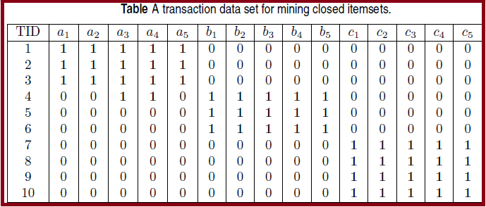
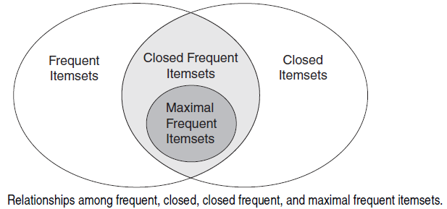

Slide 78
Maximal vs Closed Itemsets

Slide 79
FP-Growth Algorithm*
FP-growth algorithm takes a different approach to discovering frequent itemsets. The algorithm encodes the data set using a compact data structure called an FP-tree and extracts frequent itemsets directly from this structure.
FP-Tree Representation
An FP-tree is a compressed representation of the input data.
It is constructed by reading the data set one transaction at a time and mapping each transaction onto a path in the FP-tree.
As different transactions can have several items in common, their paths might overlap.
The more the paths overlap with one another, the more compression we can achieve using the FP-tree structure.
If the size of the FP-tree is small enough to fit into main memory, this will allow us to extract frequent itemsets directly from the structure in memory instead of making repeated passes over the data stored on disk.

Slide 80
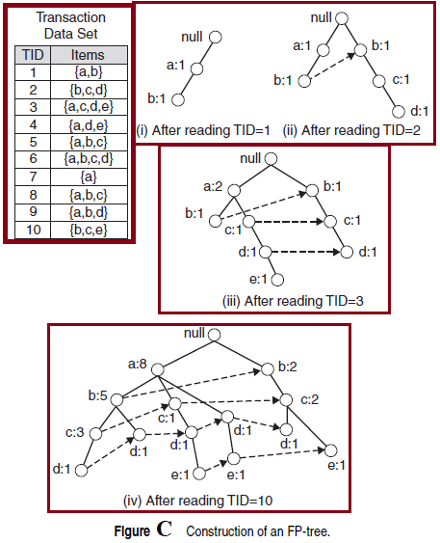

Slide 81
Figure C shows a data set that contains ten transactions and five items. The structures of the FP-tree after reading the first three transactions are also depicted in the diagram.
Each node in the tree contains the label of an item along with a counter that shows the number of transactions mapped onto the given path.
Initially, the FP-tree contains only the root node represented by the null symbol. The FP-tree is subsequently extended in the following way:
The data set is scanned once to determine the support count of each item. Infrequent items are discarded, while the frequent items are sorted in decreasing support counts inside every transaction of the data set. For the data set shown in Figure C, a is the most frequent item, followed by b, c, d, and e.
2. The algorithm makes a second pass over the data to construct the FPtree. After reading the first transaction, {a, b}, the nodes labeled as a and b are created. A path is then formed from null → a → b to encode the transaction. Every node along the path has a frequency count of 1.

Slide 82
3. After reading the second transaction, {b,c,d}, a new set of nodes is created for items b, c, and d.
A path is then formed to represent the transaction by connecting the nodes null → b → c → d.
Every node along this path also has a frequency count equal to one. Although the first two transactions have an item in common, which is b, their paths are disjoint because the transactions do not share a common prefix.
4. The third transaction, {a,c,d,e}, shares a common prefix item (which is a) with the first transaction. As a result, the path for the third transaction, null → a → c → d → e, overlaps with the path for the first transaction, null → a → b.
Because of their overlapping path, the frequency count for node a is incremented to two, while the frequency counts for the newly created nodes, c, d, and e, are equal to one.

Slide 83
5. This process continues until every transaction has been mapped onto one of the paths given in the FP-tree. The resulting FP-tree after reading all the transactions is shown at the bottom of Figure C.
Q1. What does Apriori algorithm do?
It mines all frequent patterns through pruning rules with lesser support
It mines all frequent patterns through pruning rules with higher support
Both a and b
None of the above
Ans: a
Q2. What does FP growth algorithm do?
It mines all frequent patterns through pruning rules with lesser support
It mines all frequent patterns through pruning rules with higher support
It mines all frequent patterns by constructing a FP tree
All of the above
Ans: c

Slide 84
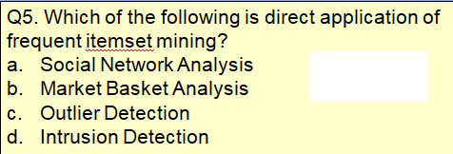
Q3. What do you mean by support(A)?
Total number of transactions containing A
Total Number of transactions not containing A
Number of transactions containing A / Total number of transactions
Number of transactions not containing A / Total number of transactions
Q4. How do you calculate Confidence(A -> B)?
Support(A ∩ B) / Support (A)
Support(A ∩ B) / Support (B)
Support(A ∪ B) / Support (A)
Support(A ∪ B) / Support (B)
Ans: c
Ans: c
Ans: b

